Slide 1
Introduction to Collision Detection
1

Slide 2
Overview
The problem can be defined as
if, when and where
two objects intersect

Slide 3
Collision Detection
Collision Detection
Determining if two objects intersect (true or false)
Example: did bullet hit opponent
Collision Resolution (Collision Determination)
Determining when two objects came into contact
  At what point during their motion did they intersect?
  Example: Two balls needing to bounce off each other
Determining where two objects intersect
  Which points on the objects touch during a collision?
  Example: Pong – where the ball hits the paddle is important
Complexity of answering these questions increases in order given
  IF < WHEN < WHERE

Slide 4
Keys to Collision Detection
Key constraint: only 16.667ms per clock tick
  Limited time to perform collision detection
Object shapes in 2D games can be quite complex
  Naïve: check two objects pixel-by-pixel for collisions
Many objects can potentially collide
  Naïve: check every object pair for collisions
Drawback of naïve approach
  Takes too long
  Doesn’t scale to large numbers of objects
Approaches for scaling
  Reduce # of collision pairs
  Reduce cost of each collision check

Slide 5
Naïve Collision Detection: n x n checking
Assume
  n objects in a game
  All n objects can potentially intersect with each other
Conceptually easiest approach
  Check each object against every other object for intersections
  Leads to (n-1) + (n-2) + … + 1 = n(n-1)/2 = O(n²) checks
  Done poorly, can be exactly n² checks
  Example: 420 objects leads to 87,990 checks per clock tick

Slide 6
Broad vs. Narrow Sweep
With many small objects in a large playfield
  Each object only has the potential to collide with nearby objects
Broad Sweep
Perform a quick pass over n objects to determine which pairs have potential to intersect p
Narrow Sweep
Perform p x p check of object pairs that have potential to intersect
Dramatically reduces # of checks

Slide 7
Broad Sweep Approaches
Grid
Divide playfield into a grid of squares
Place each object in its square
Only need to check contents of square against itself and neighboring squares
Space partitioning tree
Subdivide space as needed into rectangles
Use tree data structure to point to objects in space
Only need to check tree leaves
Quadtree, Binary Space Partition (BSP) tree

Slide 8
Reducing Cost of Checking Two Objects for Collision
General approach is to substitute a bounding volume for a more complex object
Desirable properties of bounding volumes
  Inexpensive intersection tests
  Tight fitting
  Inexpensive to compute
  Easy to rotate and transform
  Low memory use

Slide 9
Axis-Aligned Bounding Boxes (AABBs)
struct Point {
int x;
int y;
}
Three common representations
Min-Max
Min-Widths
Center-Radius
min
// min.x<=x<=max.x
// min.y<=y<=max.y
struct AABB {
Point min;
Point max;
}
// min.x<=x<=min.x+dx
// min.y<=y<=min.y+dy
struct AABB {
Point min;
int dx; // x width
int dy; // y width
}
// | c.x-x | <= rx | c.y-y | <= ry
struct AABB {
Point c;
int rx; // x radius
int ry; // y radius
}
max
min
dx
dy
ry
c
rx

Slide 10
AABB Intersection (min-max)
a.max.x<b.min.x
a.min.x=b.min.x
a.min.x>b.max.x
Two AABBs intersect only if they overlap on both axes
a.max.y<b.min.y
bool IntersectAABB (AABB a, AABB b)
{
if (a.max.x < b.min.x ||
a.min.x > b.max.x) return false;
if (a.max.y < b.min.y ||
a.min.y > b.max.y) return false;
return true;
}
a.min.y=b.min.y
a.min.y>b.max.y

Slide 11
AABB Intersection (min-width)
-(a.min.x-b.min.x)>a.dx
(a.min.x-b.min.x)>b.dx
Two AABBs intersect only if they overlap on both axes
a.min.x=b.min.x
-(a.min.y-b.min.y)>a.dy
bool IntersectAABB(AABB a, AABB b)
{
int t;
t=a.min.x-b.min.x;
if (t > b.dx || -t > a.dx) return false;
t=a.min.y-b.min.y;
if (t > b.dy || -t > a.dy) return false;
return true;
}
// Note: requires more operations than
// min-max case (2 more subtractions, 2 more negations)
a.min.y=b.min.y
(a.min.y-b.min.y)>b.dy

Slide 12
AABB Intersection (center - radius)
b.c.x-a.c.x >
a.rx+b.ry
a.c.x-b.c.x >
a.rx+b.rx
Two AABBs intersect only if they overlap on both axes
a.c.x=b.c.x
b.c.y-a.c.y > a.ry+b.ry
bool IntersectAABB(AABB a, AABB b)
{
if (Abs(a.c.x – b.c.x) > (a.r.dx + b.r.dx)) return false;
if (Abs(a.c.y – b.c.y) > (a.r.dy + b.r.dy)) ) return false;
return true;
}
// Note: Abs() typically single instruction on modern processors
a.c.y=b.c.y
a.c.y-b.c.y >
a.ry+b.ry

Slide 13
Uniform Grids
Fast mechanism for reducing the problem
Steps
Divide the world into a grid of equal sized cells
Associate each object with the cells it overlaps
Only objects sharing a cell are compared
Serves 2 purposes
Reduces the problem for sprite-sprite collision detection
Provides solution for easy sprite-world collision detection

Slide 14
Calculating Grid Position
What cells does our sprite currently occupy?
How would you calculate that?
  For min/max tile rows/columns:
  sprite.X / tile.Width
  sprite.Y / tile.Height
  (sprite.X + sprite.Width) / tileWidth
  (sprite.Y + sprite.Height) / tileHeight
  For this character, cells (0, 0), (0, 1), (1, 0) & (1, 1)
  Only test against:
  Other objects in those cells
  Collidable tiles in those cells (treat like objects)
    Don’t let sprites occupy “collidable cells”

Slide 15
XNA and Rectangle methods
Given two rectangles rectangleA and rectangleB
Rectangle.Intersects (Rectangle)
Returns true if the rectangles are intersecting, otherwise false
Example:
  bool overlaps = rectangleA.Intersects (rectangleB);
Rectangle.Intersect (Rectangle, Rectangle) // static method
Returns the area where the two rectangles overlap, an empty rectangle if there is no overlap
Example:
  Rectangle overlap = Rectangle.Intersect (rectangleA, rectangleB);

Slide 16
Object Tests Premise
Think of all collision tests as between pairs of collidable objects
In our games this means:
Sprite object to game tile object
Sprite object to sprite object
In a single game loop, for each sprite, we may have to check against:
Many other sprites
Many other tiles

Slide 17
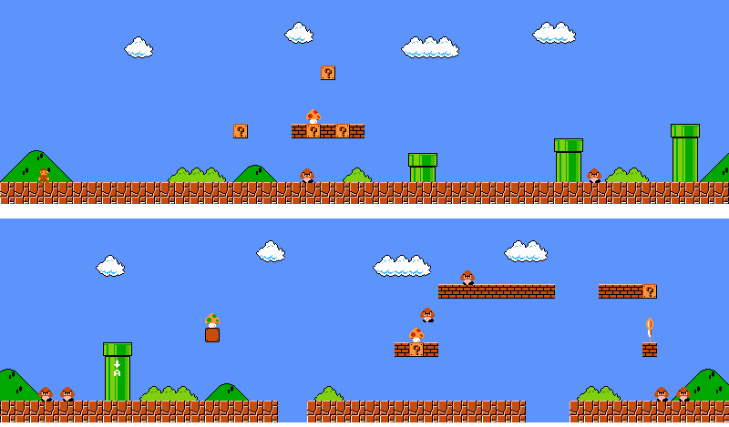
Why does this matter…

Slide 18
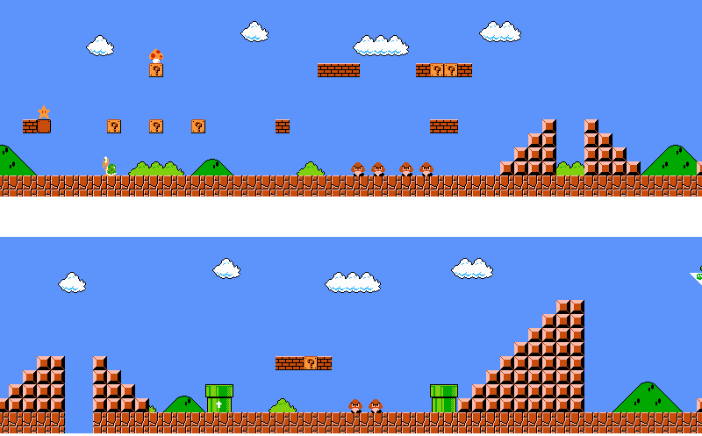
Why does this matter…

Slide 19
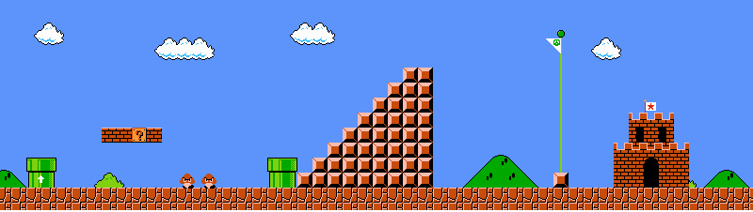
Why does this matter…

Slide 20
Priori vs. Posteri
Approaches to collision detection & response
Priori: check if something is going to collide before moving it, then make the necessary correction
Posteri: check if something has collided and make the necessary corrections

Slide 21
Discrete vs. Continuous Collision Detection
Discrete collision detection
  Perform collision detection at sampled instances of time (like end of frame)
  Can lead to tunneling problems
  “contact data is obtained by computing the penetration depth of a collision”
Continuous collision detection
  Perform collision detection in continuous space-time

Slide 22
Time in between frames
We will make calculations and update velocities and positions at various times
When?
In response to:
  Input at start of frame
  AI at start of frame
  Collision/physics when they happen
    Likely to be mid-frame

Slide 23
Be careful of Tunneling
An object moves through another object because collision is never detected

Slide 24
One way to avoid Tunneling
Swept shapes
Potential problem:
  False Positives
  Good really only for early rejection tests

Slide 25
Continuous Collision Detection
For each moving object, compute what grid cells it occupies and will cross & occupy if its current velocity is added
Find the first contact time between each object pair that may occupy the same grid cells
Sort the collisions, earliest first
Move all objects to time of first collision, updating positions
Update velocities of collided objects in pair
Go back to 1 for collided objects only
If no more collisions, update all objects to end of frame

Slide 26
Times as %
You might want to think of your times as % of the frame
Then correct positions according to this %
For example, if I know my object is supposed to move 10 units this frame (we’ve locked the frame rate), if a collision happens ½ way through, move all affected objects ½ distance of their velocity and recompute collisions data for collided data
Re-sort collisions and find next contact time

Slide 27
% Example
A at (1, 5), velocity of (4, -3)
B stationary at (4, 4)
When will they collide?
  When A goes one unit to the right
  How long will that take?
  If it takes 1 frame to go 4 units, it will take .25 frames to go 1

Slide 28
What about 2 moving objects
Solution, give the velocity of one to the other for your calculations
  make one of them stationary
  then do the calculation as with grid tiles
  make sure you move both objects
  make sure you update the velocities of both objects

Slide 29
Mind your Collision Boundaries
The collision boundary of a friendly object is bigger than the object.
The collision boundary of a harmful object is smaller than the object.
  Friendly objects include power-ups
  Harmful objects include enemies
The bigger collision makes it easier to interact with, or collect the friendly object. The smaller collision makes it easier to avoid the harmful object.

Slide 30
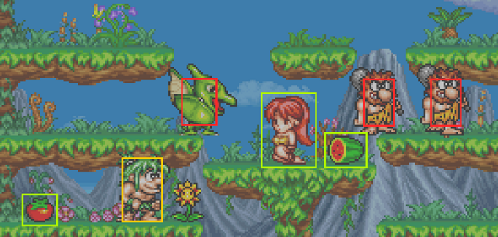
Mind your Collision Boundaries
The green rectangles are the collision boundaries of friendly objects, and the red rectangles are harmful objects. The yellow rectangle is the player.

Slide 31
?

Slide 32
References
Catto, Erin. Collision Detection & Response

